Slide 1
B.TECH IN CSE
“Retail Customer Segmentation Using Purchase Behaviour. ”
RAI TECHNOLOGY UNIVERSITY
BANGALURU
Presented By: Submitted To:
G ROSHAN ZAMEER Mr. Abhishek S
RTU24101CS035 Project Guide

Slide 2
CONTENT
Introduction
Problem Statement
Literature Survey
Proposed Solution and Methodology
Solution Development
Scalability& Performance analysis
Conclusion

Slide 3
INTRODUCTION
Retail businesses generate large amounts of customer transaction data through their purchasing activities. Analysing this data helps businesses understand customer behaviour and identify different customer groups.Customer segmentation divides customers into groups based on similarities in their purchasing patterns.This project applies machine learning clustering techniques such as K-Means, Hierarchical Clustering, and DBSCAN to identify meaningful customer segments.
The system uses customer-level features such as Number of Orders, Total Quantity, Total Spending, and Average Order Value.

Slide 4
PROBLEM STATEMENT
Retail transaction datasets contain large amounts of customer purchase information, making manual analysis difficult.
Traditional customer grouping methods may not effectively identify hidden purchasing patterns.
The major challenges include:
Difficulty in identifying different customer behaviour patterns
Large volume of transaction data
Lack of automated customer segmentation
Difficulty in identifying high-value and low-value customers
Need for an interactive system for analysing segmentation results

Slide 5
LITERATURE SURVEY
K-Means Clustering
K-Means is widely used for customer segmentation by grouping customers according to similarity and distance from cluster centroids.
Hierarchical Clustering
Hierarchical clustering creates groups based on similarity between observations and provides a hierarchical representation of customer groups.
DBSCAN
DBSCAN is a density-based clustering algorithm capable of identifying clusters and unusual observations or noise points.

Slide 6
PROPOSED SOLOUTION AND METHODOLOGY
Retail Customer Segmentation System
The proposed system follows the following process:
Data Collection → Data Preprocessing → Feature Engineering → Feature Scaling → Clustering → Model Evaluation → Customer Segmentation → Web Application
Algorithms Used
K-Means Clustering
Hierarchical Clustering
DBSCAN
Features Used
Number of Orders
Total Quantity
Total Spending
Average Order Value

Slide 7
SOLUTION DEVELOPMENT
The Online Retail dataset was used for developing the customer segmentation system.
Data Processing
Original records: 541,909
Processed records: 392,692
Customers identified: 4,338
Preprocessing
Removed missing CustomerID records
Removed cancelled invoices
Removed invalid quantities and prices
Removed duplicate records
Calculated total transaction amount
Aggregated transactions at customer level
Applied feature scaling
The processed customer data was used to train the clustering models.

Slide 8
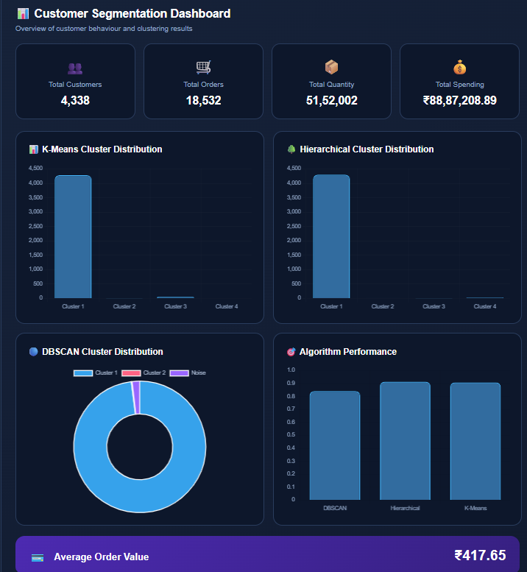
Federated Learning Training Accuracy

Slide 9
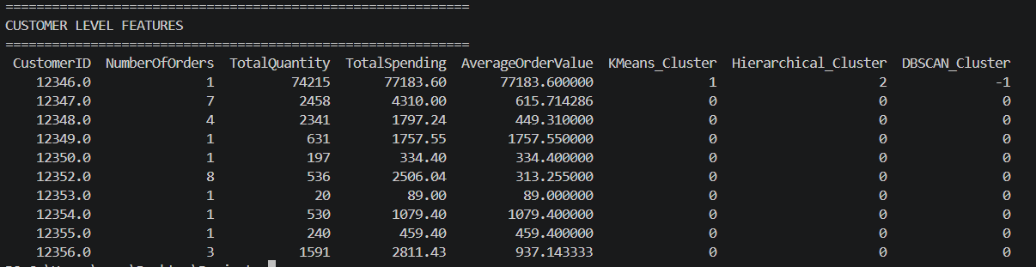
SCALABILITY & PERFORMANCE ANALYSIS

Slide 10
CONCLUSION
The project successfully developed a machine learning-based system for Retail Customer Segmentation Using Purchase Behaviour.
The Online Retail dataset was processed to generate meaningful customer-level purchasing features.
Three clustering algorithms, K-Means, Hierarchical Clustering, and DBSCAN, were implemented and evaluated using silhouette scores.
The resulting clusters were interpreted into meaningful customer segments based on purchasing behaviour.

Slide 11
Thank you all

